Slide 1



Business Process Engineering
TEAM 7
Aaradhya Sharma
Riti Gawade

Slide 2
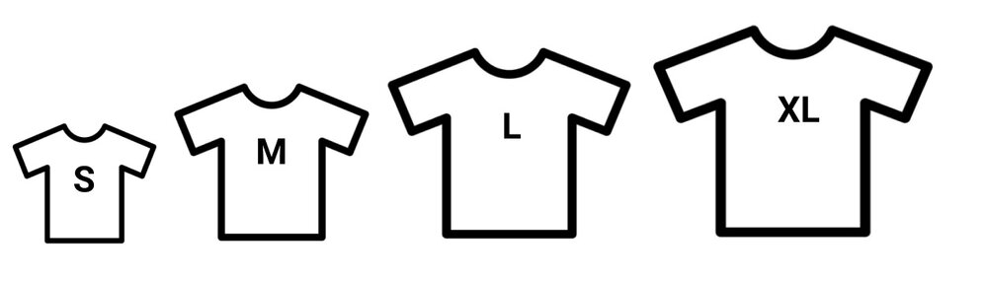
Backlog Prioritization
T Shirt Sizing technique

Slide 3
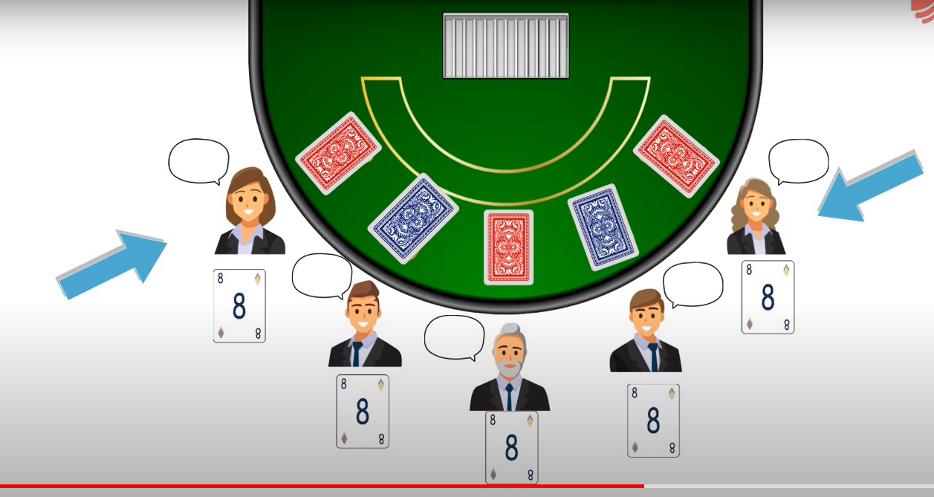
Planning poker

Slide 4
Current sprint and future
Current Sprint
Hydraulic brakes (3)
Heated seats (5)
Power windows (8)
Power locks (5)
All-weather floor mats (1)
Power steering (3)
Parallel parking assist (8)
Cup holders (1)
Future Item
Total 34
Fold-down rear seat
Turn by turn navigation (8)
etc

Slide 5
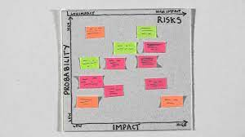
Information Radiation

Slide 6
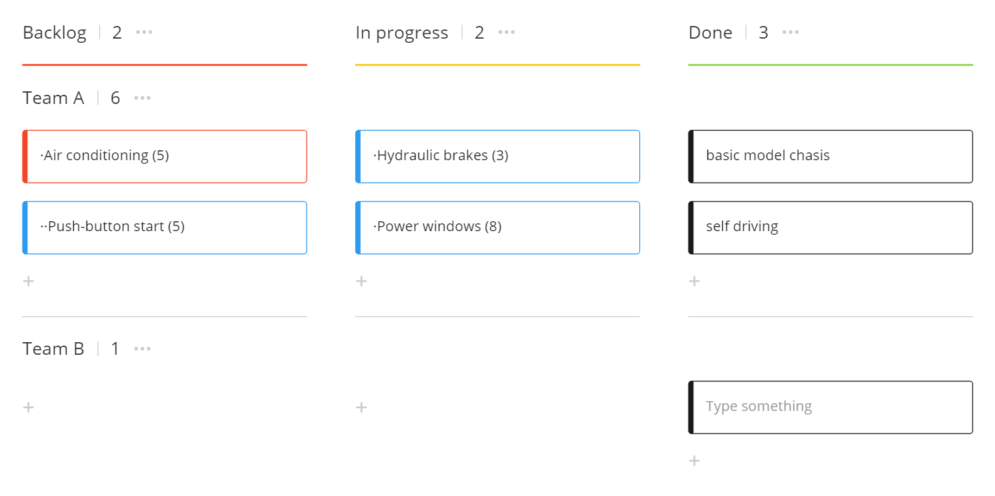
Kanban board

